Slide 1
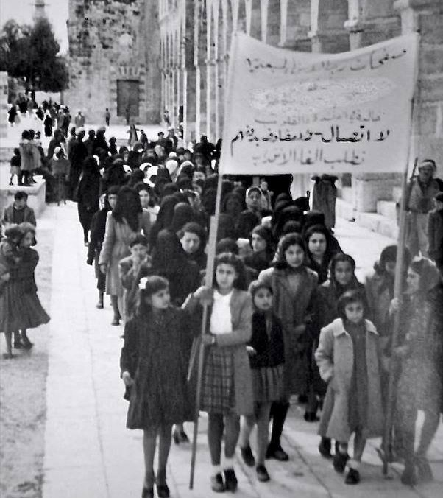
What happened in 1920s and 1930s Mandate Palestine?
Lesson 5

Slide 2
Learning objectives
By the end of this lesson, you should be able to:
Outline the political situation in 1920s and 1930s Mandate Palestine
Explain the increasing tension between Palestinians and Jews at this time
Give some examples of the unrest that occurred during this period

Slide 3
Recap:
What was ‘Mandate Palestine’?
Why was there a Mandate for Palestine?
How long did Britain govern Palestine for?
When Britain governed Palestine-Israel under a League of Nations Mandate
Because after WWI the League of Nations decided that the territories of the defeated Ottoman Empire should be ruled by the victorious powers of Britain and France. Britain was given the Mandate for Palestine with the idea that Britain would govern Palestine until Palestine was ready to “stand alone”
British governance of Palestine lasted for 28 years. Britain was assigned the Mandate in April 1920, and in July 1920 it established a civil administration in the country. In May 1948, the British left

Slide 4
Today’s keywords – what could they mean? Discuss in pairs
Arab Revolt of 1936-1939
Arab Executive
Jewish National Council
Yishuv
Jewish Agency

Slide 5
Today’s keywords – add these to your glossaries
Arab Revolt of 1936-1939
a nationalist uprising of Palestinian Arabs against the British administration of the Palestine Mandate
Arab Executive
the main Palestinian nationalist group in 1920s Mandate Palestine
Jewish National Council
the main organisation concerning Jewish welfare, education, local government and security in Mandate Palestine
Yishuv
the Jewish community in pre-1948 Palestine-Israel
Jewish Agency
a branch of the World Zionist Organisation, established in 1929

Slide 6
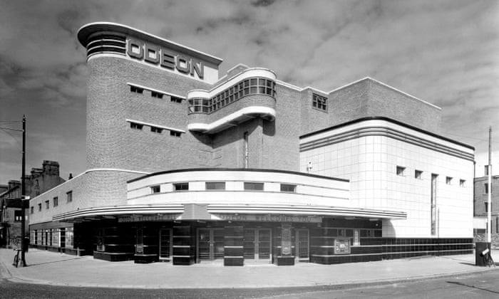
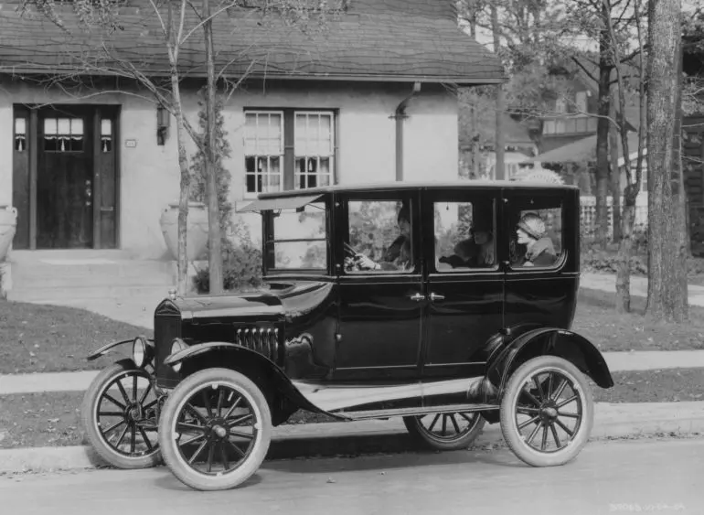
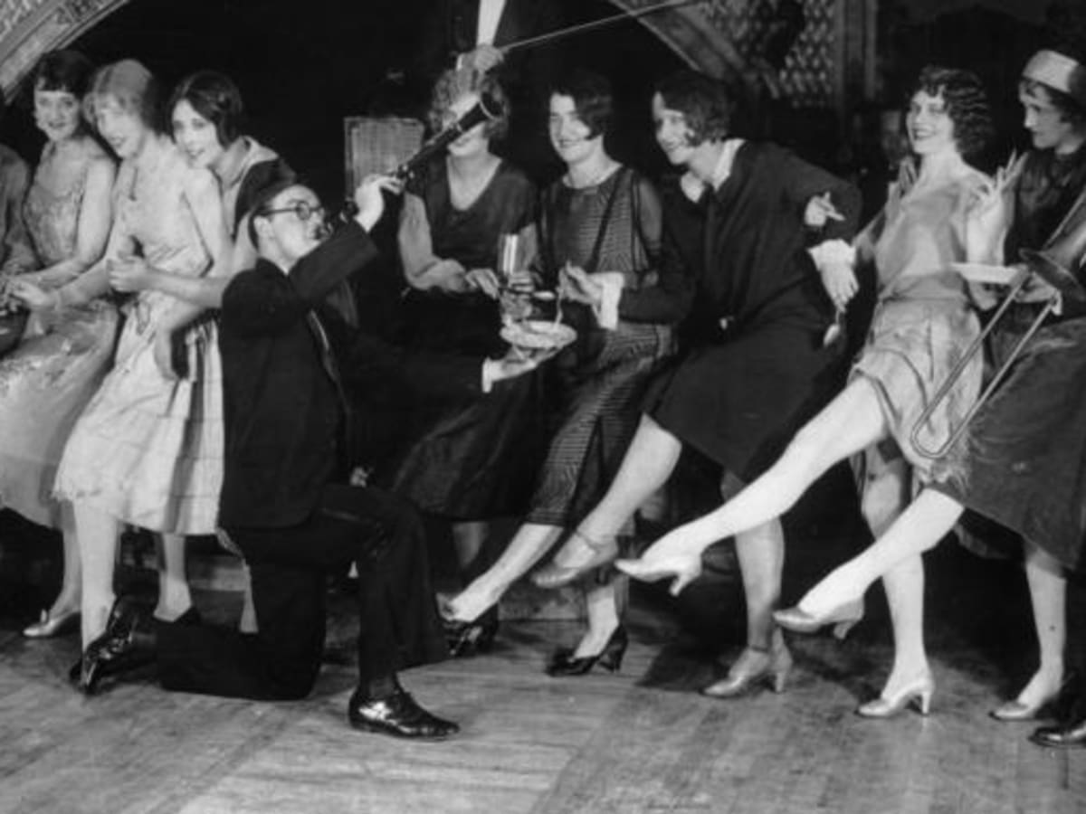
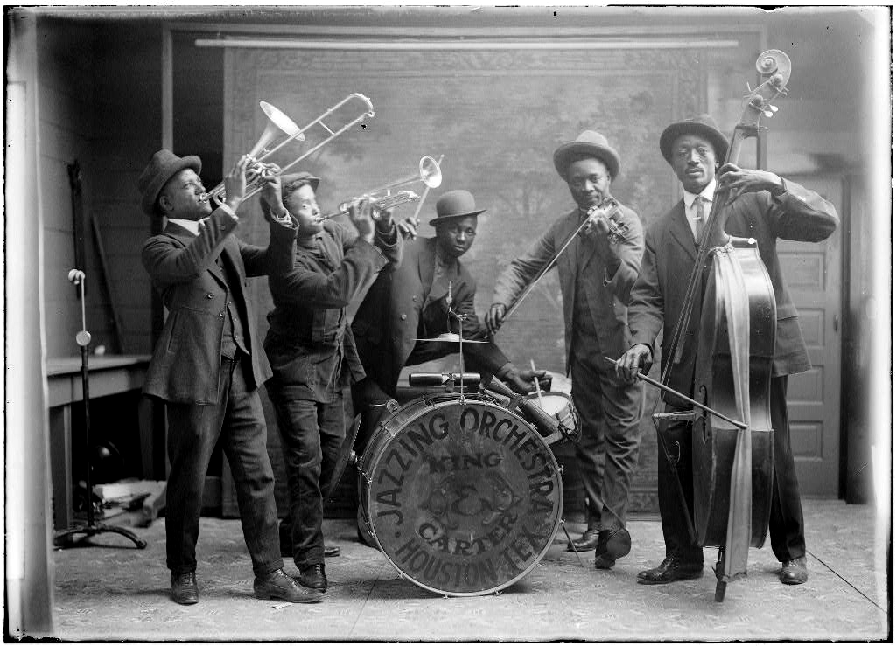
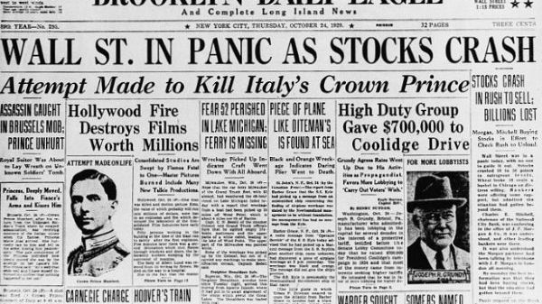
Starter activity
Setting the Scene: the 1920s and 1930s
With the person next to you:
Thinking outside Palestine-Israel, what do you know about life in the 1920s and 1930s?
What words come to mind? Jot these down. You can also use the images to help you

Slide 7
Starter activity
Setting the Scene: the 1920s and 1930s
War was over… time to celebrate!
The ‘Jazz Age’ or ‘Roaring Twenties’
Cheaper mass-produced cars (particularly in the USA)
Public radio broadcasting began
Odeon cinemas opened in the 1930s
The zip was invented!
However:
Wall Street Crash of 1929
Fascism first appeared during this period
Life became more ‘modern’ in Mandate Palestine at this time too…

Slide 8
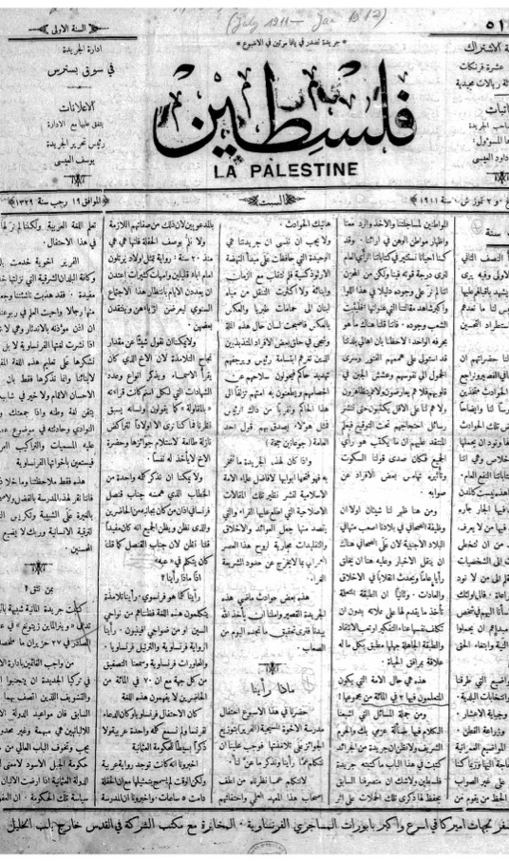
Starter activity
Modernisation in Mandate Palestine
The electrification of Palestine: Jaffa Electric Company was founded in 1923
Travel:
Palestine Airways was founded in 1934
The Palestine Railways were developed throughout this period
The position of women was increasingly discussed in the Palestinian press at this time. Jaffa’s Filastin (from Lesson 3) regularly published on this topic, with titles including ‘The Veil and the Duty to Lift It’ and ‘The Necessity to Liberate Women’
Palestinian women’s activism during the British Mandate
Falastin: a Palestinian national newspaper established in 1911

Slide 9
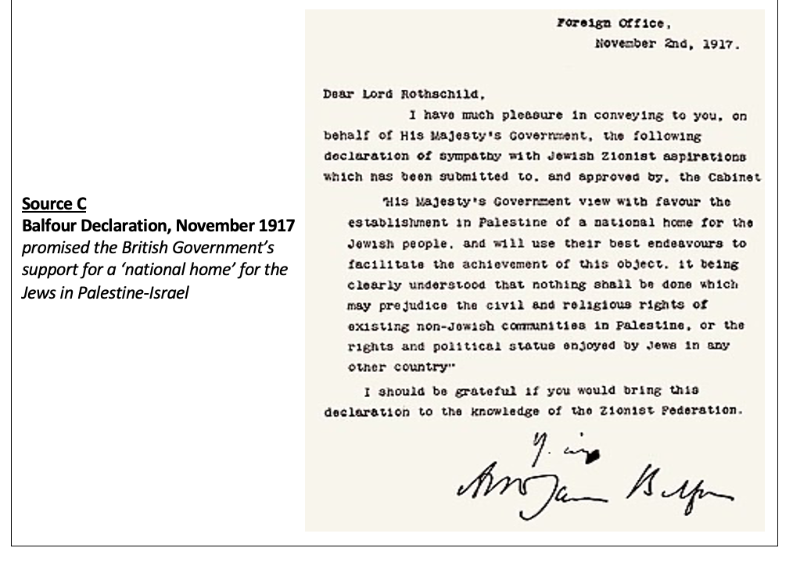
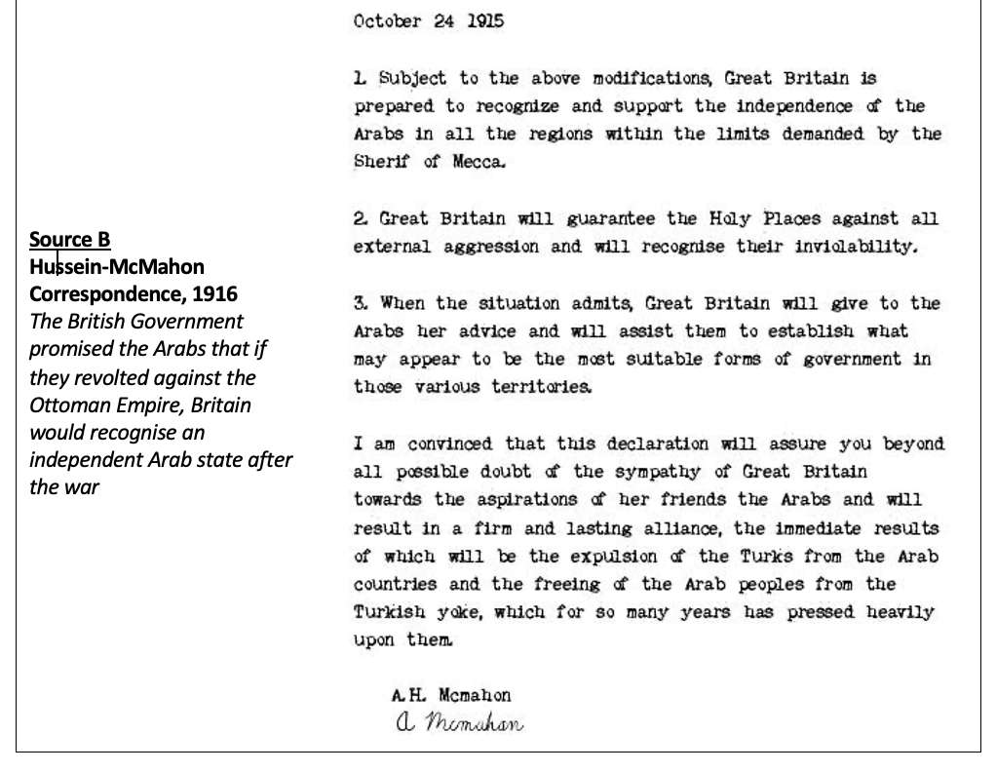
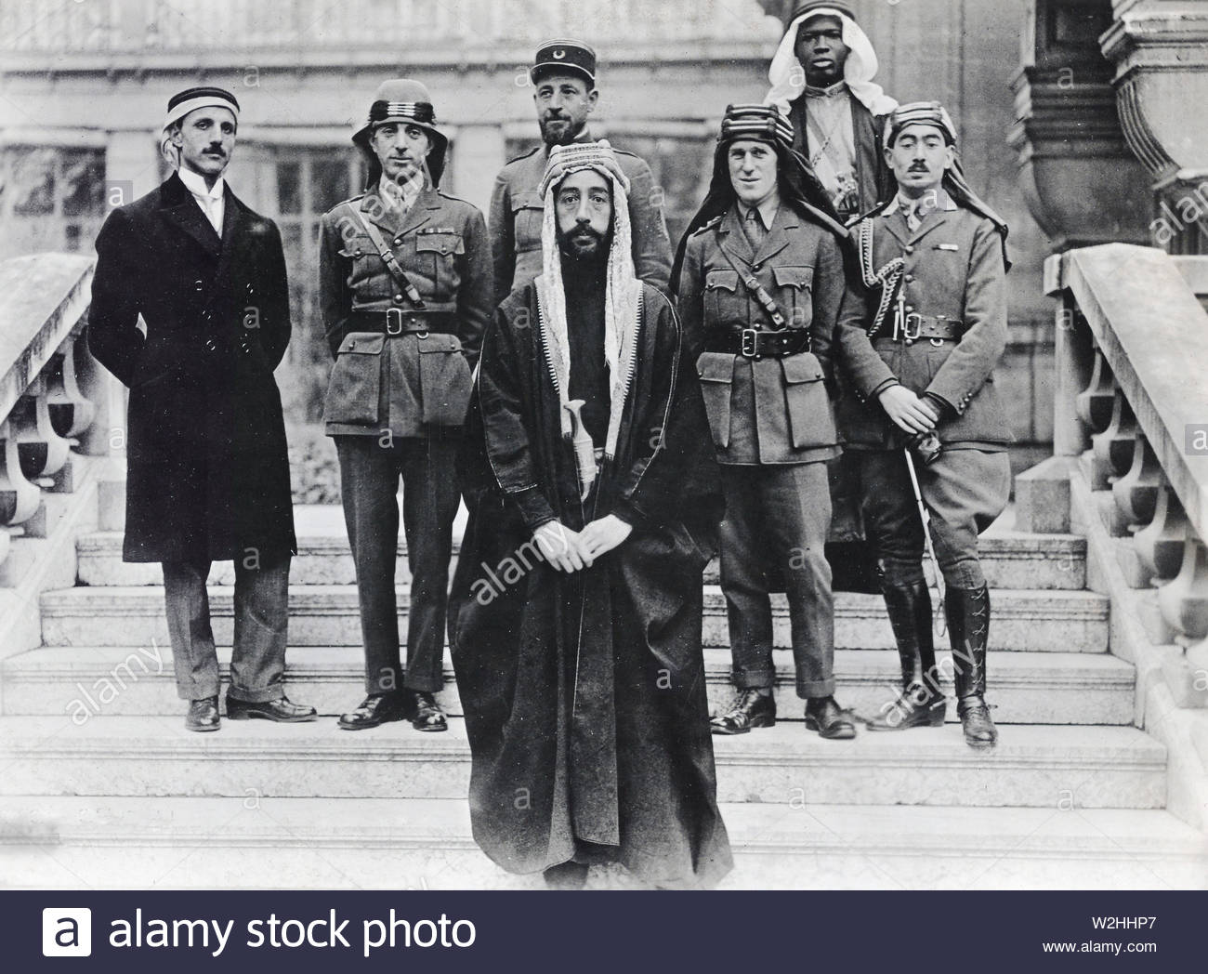
Britain’s conflicting promises: what do you remember?
Hussein-McMahon Correspondence → what was promised and why was this problematic?
Under the Hussein-McMahon Correspondence, Britain promised to recognise Arab independence after the war
But with the creation of ‘Mandate Palestine’, this promise was broken. The Arabs of Palestine (the Palestinians) were now going to be governed by Britain. They were not given the independence that was promised to them
Balfour Declaration → what was promised and why was this problematic?
Under the Balfour Declaration, Britain had promised its support for a ‘national home’ for Jews in Palestine-Israel
→ The Balfour Declaration was incorporated into the Mandate, but what would this look like in reality?
The British Mandate for Palestine → what was this?
Under the British Mandate for Palestine, Britain had promised the League of Nations that it would govern Palestine until Palestine was ready to ‘stand alone’
→ But what did this mean?
We are going to look at what this meant for 1920s and 1930s Palestine

Slide 10
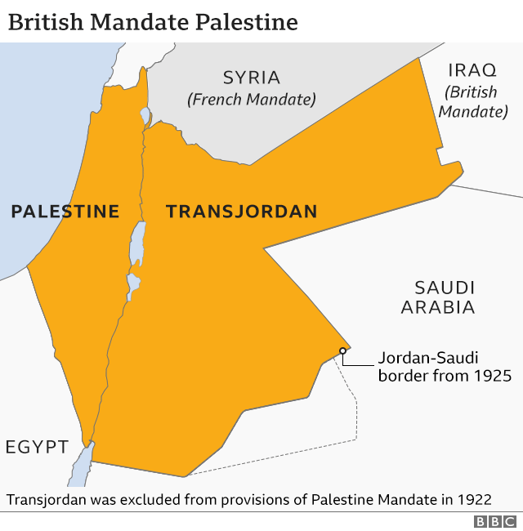
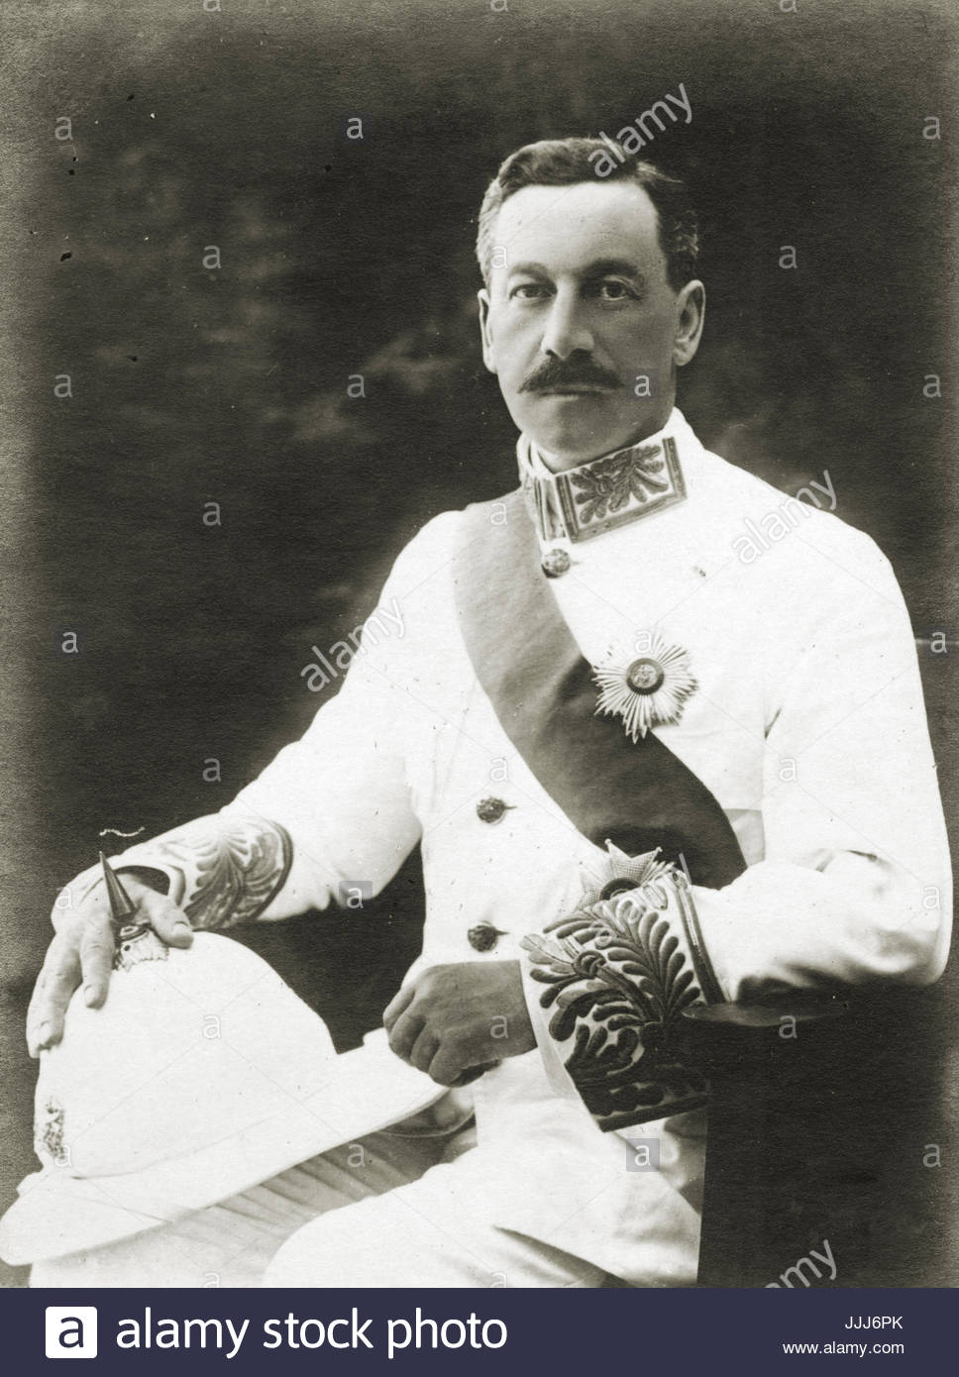
The political situation: the British
As we learnt last lesson, the Palestine Mandate was split into Mandate Palestine and Mandate Transjordan in 1922. Our focus is Mandate Palestine
Although it was technically a Mandate, British governance of Palestine was quite colonial in nature
The British Administration in the country reported to the Colonial Office, and the system of government was based on the ‘traditional hierarchy’ of the British Crown colonies
There were various levels to the British Administration in Mandate Palestine:
High Commissioner (eg. Herbert Samuel, 1920-1925)
Executive Council of high-ranking officials
A mixed Advisory Council with no executive authority
A country-wide Civil Administration, the senior ranks of which were occupied by British men, with the more junior positions distributed among carefully selected Palestinians and Jews
Herbert Samuel, the first High Commissioner of Palestine, 1920-1925

Slide 11
5a Worksheet
Activity 1
Using the information provided, create a pyramid of power for the British administration in Mandate Palestine. You will need to include the following:
Other British men in the Civil Administration
Advisory Council
High Commissioner
Palestinians and Jews in the Civil Administration
Executive Council
High Commissioner
Executive Council
Advisory Council
Other British men in the Civil Administration
Palestinians and Jews in the Civil Administration

Slide 12
The political situation: Palestinians and Zionists
British policy in Mandate Palestine was characterised by ineffectiveness and instability, as Britain found itself being pulled in different directions by Palestinians and Zionists
The Palestinians
At first, Muslim-Christian Associations were established across Palestine. In 1919, these associations came together to establish the Palestine Arab Congress
At the third Palestine Arab Congress, the Arab Executive was established. This became the main Palestinian nationalist group in 1920s Palestine
Then, at the start of the Great Arab Revolt in 1936, the Arab Executive was replaced with the Arab Higher Committee
What did Palestinians want?
The Palestinians had been promised their independence for rising up against the Ottoman Empire – they wanted a Palestinian state!
The Zionists
At the First Zionist Congress in Basle in 1897, the Zionist Organisation was established. The Zionist Organisation led the Jews in Palestine until 1929, when the Jewish Agency was established as a branch of this organisation
Another important Zionist organisation was the Jewish National Council (or Vaad Leumi). This was the main organisation concerning Jewish welfare, education, local government and security in Mandate Palestine
What did Jews want?
The Jews had been promised British support for the establishment of a ‘national home’ in Palestine-Israel – they wanted a homeland!

Slide 13
5a Worksheet
Activity 2
Using the information provided, create a list of the evolution of Palestinian nationalism. You will need to include the following:
Arab Higher Committee
Muslim-Christian Associations
Arab Executive
Extension question: can you name the three main Jewish organisations in 1920s and 1930s Palestine?
Muslim-Christian Associations
Arab Executive
Arab Higher Committee

Slide 14
The daily lives of Palestinians and Jews
On a daily level, Palestinians and Jews lived quite separate lives during the Mandate
These communities were separate regarding education, health and culture
For example, 98.8% of students at Christian missionary schools were Palestinian in 1926 – just 1.2% were Jewish. The Jewish community had its own independent school system
The Palestinian and Jewish communities were also quite distinct from each other in terms of the economy and the law

Slide 15
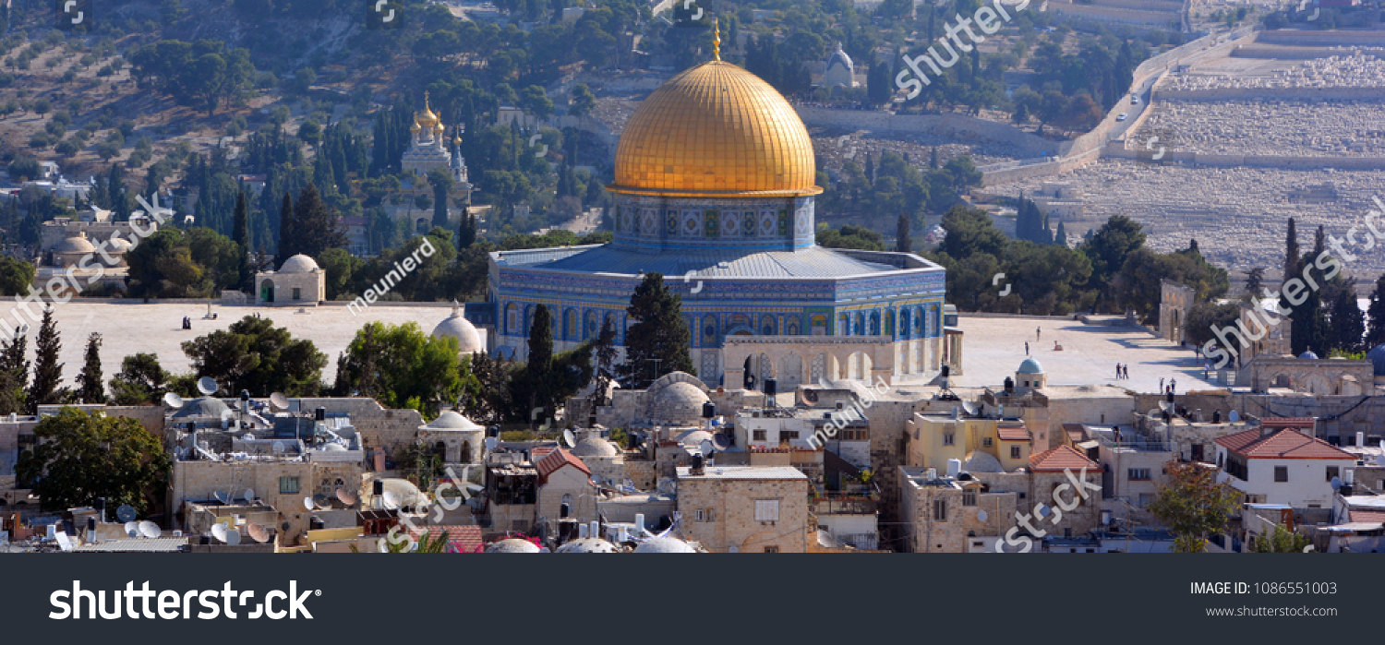
Jewish immigration to Mandate Palestine
With the person next to you:
Thinking back to our first lesson, why is Palestine-Israel (specifically Jerusalem) significant to Jews?
Religious Jews believe that all of creation began in Jerusalem. The Western Wall in the Old City of Jerusalem is the holiest place where Jews can pray. It was in Jerusalem that King Solomon built the First Temple to house the Ark of the Covenant, a sacred chest that contained the Ten Commandments. It was also where Abraham showed that he was prepared to sacrifice his son
Jews were expelled from Palestine-Israel between 8 BCE and 6 BCE (around 2000 years ago)

Slide 16
Jewish immigration to Mandate Palestine
This was one of the main sources of tension between Palestinians and Jews in 1920s and 1930s Mandate Palestine
What is immigration?
Immigration: travel to another country to become a citizen
The word ‘Aliyah’ is often used to describe the movement of Jews to Palestine-Israel. There have been several waves of this:
Pre-1882: most Jewish immigrants to Palestine-Israel settled in Jerusalem, Hebron, Tiberias or Safed
First Aliyah, 1882-1903: rather than settling in cities, these mostly Russian Jews settled in towns such as Jaffa and Haifa and founded agricultural settlements
Second Aliyah, 1903-1914: took the Yishuv population from 55,000 in 1900 to 85,000 in 1914
During the Mandate period, Jewish immigration continued
By 1931, the Jewish population in Palestine had almost doubled to 175,000
135,000 Jews arrived between 1933 and 1935, most of whom were fleeing Nazi Germany and Poland
Mandate Palestine population
Year | Palestinians | Jews
1914 | 90% | 10%
1922 | 90% | 10%
1931 | 70% | 30%
Why did Russian Jews travel to Palestine-Israel in the late 1800s?

Slide 17
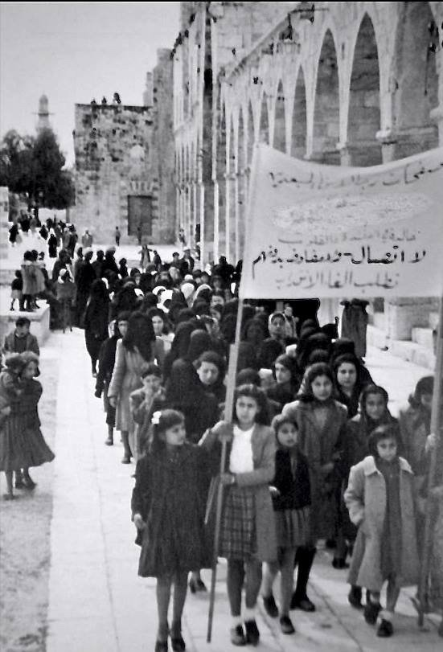
The Palestinian reaction
Jewish immigration to Mandate Palestine was problematic for the Palestinians
The Jewish Agency helped Jewish immigrants to buy land in Mandate Palestine, and land purchased by the Jewish National Fund was leased exclusively to Jews
Palestinians felt that they were losing their land and that their chances of a Palestinian state were slipping away
This came to a head with the Arab Revolt of 1936-1939, a nationalist uprising of Palestinian Arabs against the British administration

Slide 18
5b) Debating activity You are now going to be assigned a partner. You and your partner will be either ‘support for’ or ‘opposition to’ to Jewish immigration. You can spend a few minutes preparing your argument Then you will join with another pair and have a debate about Jewish immigration to Mandate Palestine What can you use from this and previous lessons to support your argument?
Support for Jewish immigration to Mandate Palestine
Ideas:
Jews had been promised British support for a national home in Palestine-Israel under the Balfour Declaration, which had been incorporated into the Mandate. Britain must now honour this promise and facilitate Jewish immigration to Mandate Palestine
After facing antisemitism for centuries, Jews were once again being treated disgracefully in Nazi Germany and across Europe: they needed a homeland now more than ever!
What else?
Opposition to Jewish immigration to Mandate Palestine
Ideas:
Palestinians had been promised an independent state for rising up against the Ottoman Empire. As the British supported Jewish immigration to Mandate Palestine, this independent Palestinian state became increasingly unlikely
The British have a responsibility as Mandatory power to uphold the rights of the Palestinians who have lived on this land for centuries – it is their homeland!
What else?

Slide 19
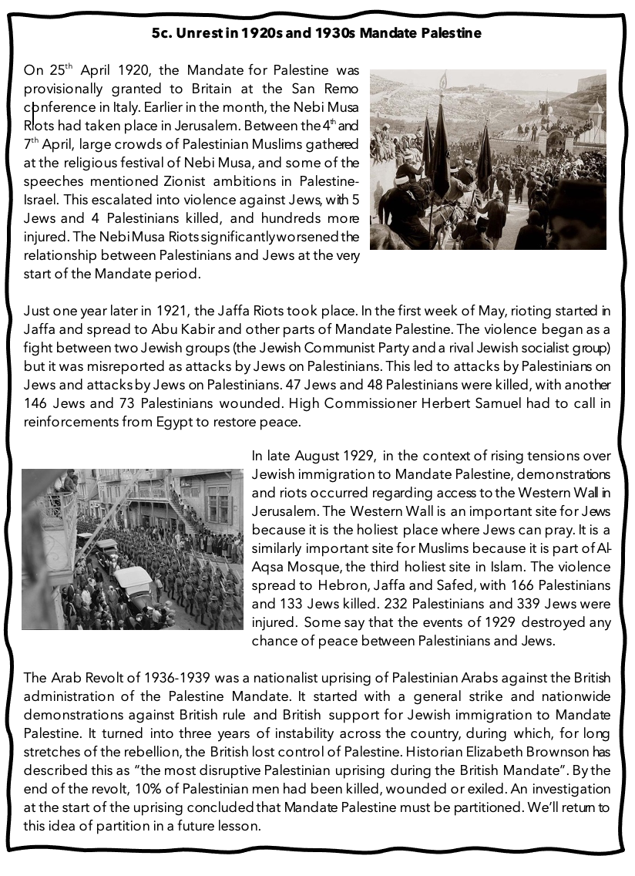
5c) Using the information on the handout, create a table of the unrest in 1920s and 1930s Mandate Palestine
Unrest: | When? | Where? | Why? | Consequences
Nebi Musa Riots
Jaffa Riots
Western Wall Riots
Arab Revolt of 1936-1939

Slide 20
Homework
Create a spider diagram of life in 1920s and 1930s Mandate Palestine
You might want to include:
The political situation (eg. the Arab Executive and Jewish Agency)
Some examples of violence
Context on Jewish immigration
The Palestinian reaction to Jewish immigration
Examples of modernisation in Palestine (eg. travel and the status of women)
Next, compare this with your spider diagram of life in nineteenth century Palestine-Israel from our first lesson. What had changed and what had stayed the same? Write a paragraph on this

Slide 21
Plenary: Answer this question with the person next to you: what three things have you learnt today about 1920s and 1930s Mandate Palestine?
Next, find another pair who you haven’t spoken to today and share your answers

